Slide 1
Curt Bonk, Professor Indiana University Scholarly Recap Productivity Data as of February 17, 2024

Slide 2
Curt Bonk, Professor, Indiana University Some Facts and Data As of February 17, 2024

Slide 3
Curt Bonk, Professor, Indiana University Publications and Scholarship Indices Facts (as of February 17, 2024)
*Highest in IU School of Ed; **Second Highest in IU School of Ed (Data based on CV, website, & other document reviews)
h-index = 73 *
i10-index = 186*
3. Citations of work = 27,560**
- - - - - - - - - - - - - - - - - - - - - - - - - - - - - - - - - - - - - - - - - -
Total publications = 417
Peer reviewed journal articles = 160
Books = 20
Book chapters =67
Other publications 167
Graduate students published with = 102 (including 25 advisees)
Total publication collaborators = 203

Slide 4
Curt Bonk, Professor, Indiana University Recent Publications and Scholarship January 2020 to February 20, 2024
(46) Peer reviewed journal articles (including 23 in SSCI journals) like BJET, ETR&D, Distance Ed, JECR, Interactive Learning Environments, JCHE, JCAL, IRRODL, APJE, and APER).
(4) Books: Two major edited books: one with 30 manuscripts and 67 contributors, “MOOCs and Open Ed in the Global South” and another book with 47 chapters and 45 contributors.
(2) one Special Issues edited (ETR&D) with 16 manuscripts and 51 contributors.
(9) Seven book chapters, prefaces, and forewords.
(2) Miscellaneous article.
= = = = = = = = = = = = = = = == = = = = = = = = = = = = =
Total: 63 Publications from January 2020 to February 20, 2024.
Plus: 18 additional articles in review as of February 20, 2024.

Slide 5
Curt Bonk, Professor, Indiana University Facts…Productivity Doubled Average Publications Per Year Since Moving to IST

Slide 6
Curt Bonk, Professor, Indiana University Average Publications Per Year has Doubled Since Moving to IST in 2005

Slide 7
Curt Bonk, Professor, Indiana University Facts (as of February 17, 2024) Presentations, Mentorship, and Media
Total presentations, invited talks, and speeches (1,884)*
Conference papers and presentations (244)
Keynotes and plenaries talks (325)
Other invited talks (250)
International and national presentations (535)
Graduate students presented with (100)
Dissertations completed (137)
Dissertations chaired or directed (44)
Current dissertation committees (18 (11 as member; 7 as chair))
Media Features: Radio (57), News (230), TV, Film, & Video (51)

Slide 8
Curt Bonk, Professor, Indiana University Facts (as of February 17, 2014) Teaching and Mentoring Recognitions
IU Campus-Wide (across 9 campuses) or State-Wide Teaching Awards (3)
IU President's Award for Excellence in Teaching and Learning Technology (2020).
Innovative Teaching Award: Teaching in a Distance Educ Program. Indiana Partnership for Statewide Education, IHETS (2005).
First recipient of the Wilbert Hites Mentoring Award at IU (2000).
(In addition, I received the Gorman Teaching Award from the School of Education (1999); Trustees’ Teaching Award in 2005 and 2009; Teaching Excellent Recognition Awards (TERA) in 1997, 1998, and 1999.)

Slide 9
Curt Bonk, Professor, Indiana University Facts (as of September 22, 2022) Average Teaching Evaluation Ratings
2005-2022 Averages below of 49 course evaluations
Note: 62 courses taught since 2005 (13 missing data)
Overall, I would rate the quality of this course as outstanding (1 to 5 scale): 4.57
Overall, I would rate this instructor as outstanding (1 to 5 scale): 4.71

Slide 10
Curt Bonk, Professor, Indiana University Facts (as of Feb. 17, 2024) Other Notable Recognitions and Awards
Awardee, Distinguished Development Award (for podcast show), ETR&D & AECT, Oct. 2022.
Fellow, American Educational Research Association (AERA), San Diego, CA, April, 2022
Award for Outstanding International Engagement, IU School of Education, April, 2022.
David H. Jonassen Excellence in Research Award. Presented at AECT, Chicago, IL, 2021.
RHSU Edu-Scholar Public Presence Rankings (top 200 list from over 20,000 university-based education scholars in the USA). In list each year from 2012-2018.
Online Learning Journal Outstanding Research Achievement Award in Online Education, Online Learning Consortium, Orlando, Florida, November 16, 2017.
AACE Fellowship Award "In Recognition of Outstanding Leadership & Service to the Profession and AACE." Presented at E-Learn 2016.
Mildred B. and Charles A. Wedemeyer Award for Outstanding Practitioner in Distance Education Award; Distance Teaching & Learning Conference, Madison, WI. 2014.
The Most Outstanding Achievement by an Individual in Higher Education Award from the United States Distance Learning Association (USDLA, 2003).
CyberStar Award, Indiana Info Tech Assoc. (INITA), Indianapolis, IN. Award Winner for: “Educational Contribution to IT in Higher Education” (2002).
Senior Research Fellow, US Dept of Defense, Advanced Distrib. Learning Lab (2003-2005).
Senior Research Fellow, U. S. Army Research Institute (1999-2003).

Slide 11
Curt Bonk, Professor, Indiana University Facts (as of February 17, 2024) Other Notable Recognitions and Awards
2023 Fellow Awardee, Online Learning Consortium (OLC). Recognized for “Extraordinary Global Leadership and Contributions to the field of Online and Blended Learning.” Presented at the OLC Accelerate Conference, Washington, D.C., October 25, 2023.
2023 Awardee, AECT Annual Achievement Award: For Accomplishments Advancing the ECT Field. Presented at the Association for Educational Communication and Technology (AECT) International Convention, Orlando, FL, October 18, 2023.
2023 Awardee, USDLA Excellence in Distance Learning Research Award in Higher Education, United States Distance Learning Association (USDLA), Orlando, FL, July 19, 2023.
2023 Awardee (with Min Young Doo, Kangwon National University, Korea), Outstanding International Research Collaboration, American Educational Research Association (AERA) TICL (Technology, Instruction, Cognition, and Learning) SIG. Presented at AERA, Chicago, IL, April 13, 2023.

Slide 12
Curt Bonk, Professor, Indiana University (as of February 17, 2024) International Collaboration, Research, and Service
Visiting scholar/professor or adjunct appointments/visits (14)*
1997-2024 (e.g., Taiwan (2), Japan, Finland (2), the UK (Wales, Scotland), Canada, China, Egypt, Thailand, Australia, and Ohio, USA).
Visiting scholars sponsored (40)
1995-2024 (e.g., from China, Korea, Taiwan, Israel, Belgium, Botswana, Mexico, Uzbekistan, Japan, Kazakhstan, Azerbaijan, Turkey, Thailand, Australia, Italy, Finland, Russia, Morocco, Palestine, South Sudan, India, New Zealand, South Africa, etc.).
Note: I have personally organized or hosted many IU and IST alumni events in Singapore (2), Thailand (2), Korea (7), Taiwan (4), and China (1).

Slide 13
Curt Bonk, Professor, Indiana University (as of February 20, 2024) International Collaboration Continued…
Recent Research Partners and Publications: Korea, China, and Turkey.
My recent teaching and service activities (mostly virtual) in such countries as: China, Korea, Taiwan, Turkey, Canada, UAE, Saudi Arabia, Japan, Thailand, Indonesia, Botswana, Singapore, Hong Kong, New Zealand, Australia, the UK, India, the Philippines, Mexico, Finland, Scotland, Ireland, Spain, Sri Lanka, Israel, Nepal, Japan, Fiji, South Africa, and Malaysia.
My new edited book (2022), Transformative Teaching Around the World” with Routledge on impactful teaching has teachers from 22 countries such as: Mexico, India, Morocco, mainland China and Taiwan, Bhutan, Papua New Guinea, Thailand, Cyprus, Singapore, Finland, Botswana, New Zealand, Yemen, Saudi Arabia, Yemen, Rwanda, Costa Rica, Kazakhstan, Israel, Uzbekistan, Korea, and the United States.
My recent 2 MOOCs books (2015 and 2020) have contributors from: South Africa, Canada, the Philippines, Thailand, China, Korea, Indonesia, Brazil, Chile, the Bahamas, India, Kenya, UAE, Egypt, Turkey, Sri Lanka, the Netherlands, Scotland, New Zealand, Australia, Japan, Germany, Australia, Ireland, Malaysia, Nepal, Fiji, Columbia, Zimbabwe, Mexico, Iran, and the United States.

Slide 14
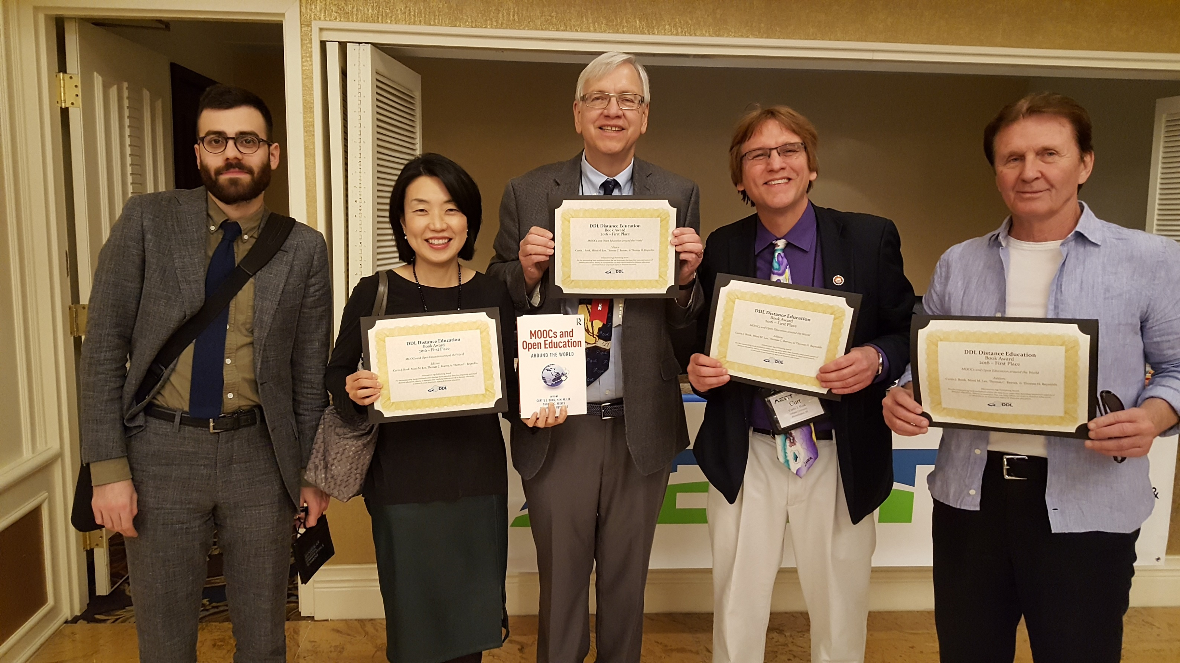
Book Project Collaborations By Year
Note: Two of my edited books feature entirely IU School of Education contributors
(e.g., Electronic Collaborators (1998) and Transformative Teaching Around the World (2022).

Slide 15
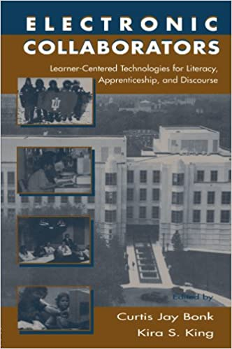
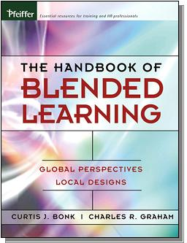
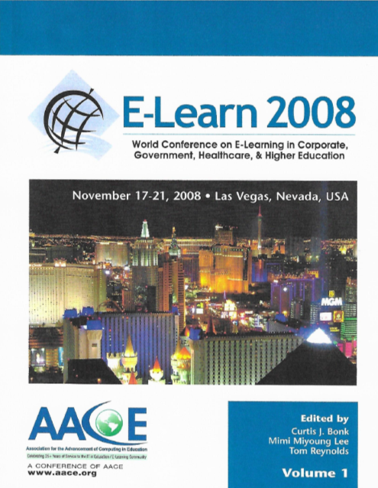
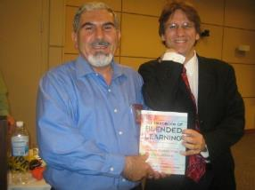
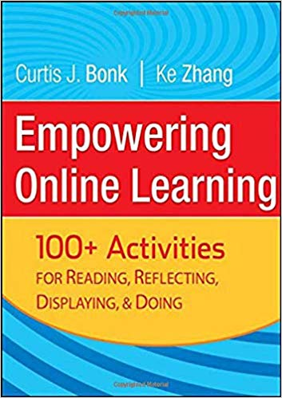
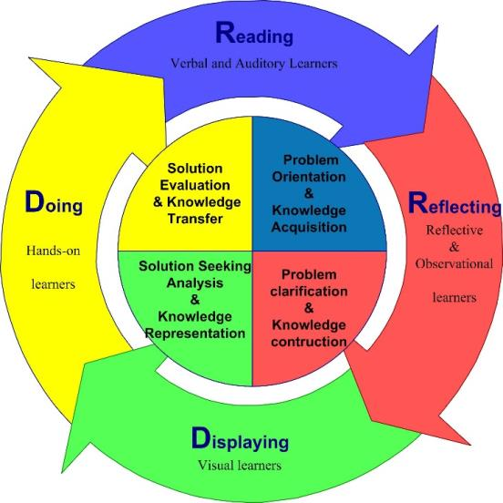
Special Issue:
Computers and
Writing
W. Michael Reed
Curtis Jay Bonk
1988
1992
1998
2000
2006
2008
(All contributors affiliated
with the IU School of Ed)
2008
2009
2009 (Expanded for paperback edition in 2011)
Notes:
World is open book

Slide 16
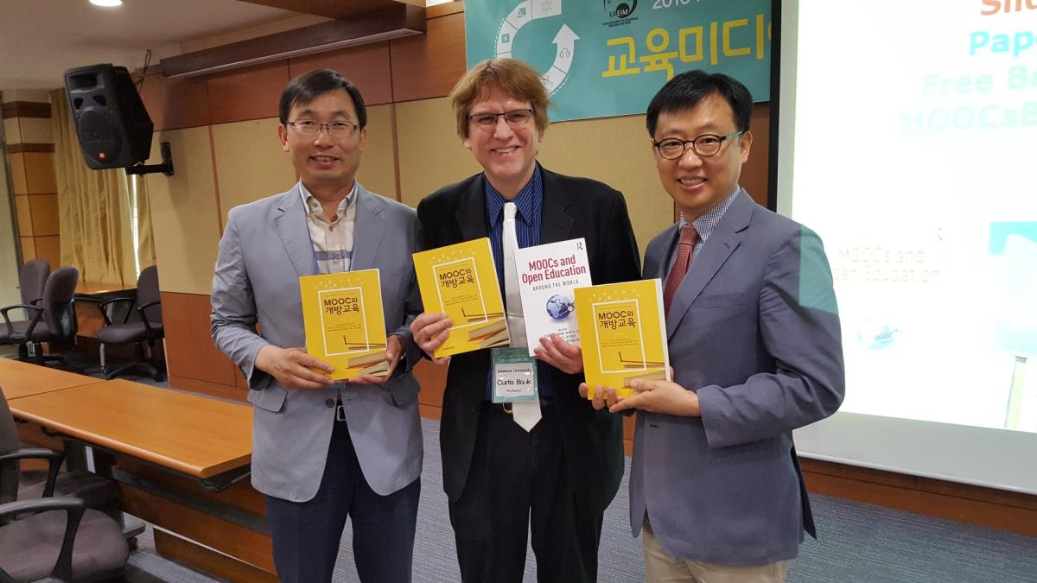
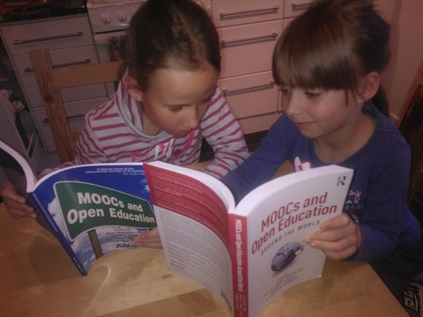
2014 (Chinese in 2015)
2015 (Chinese and Korean in 2016)
2015
2020
August 2020

Slide 17
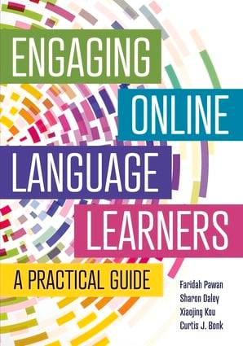
2022
(published by TESOL)
2022
(All contributors affiliated
with the IU School of Education)
2022 (free)
(New Version of the Adding Some TEC-VARIETY)
Also free course.

Slide 18
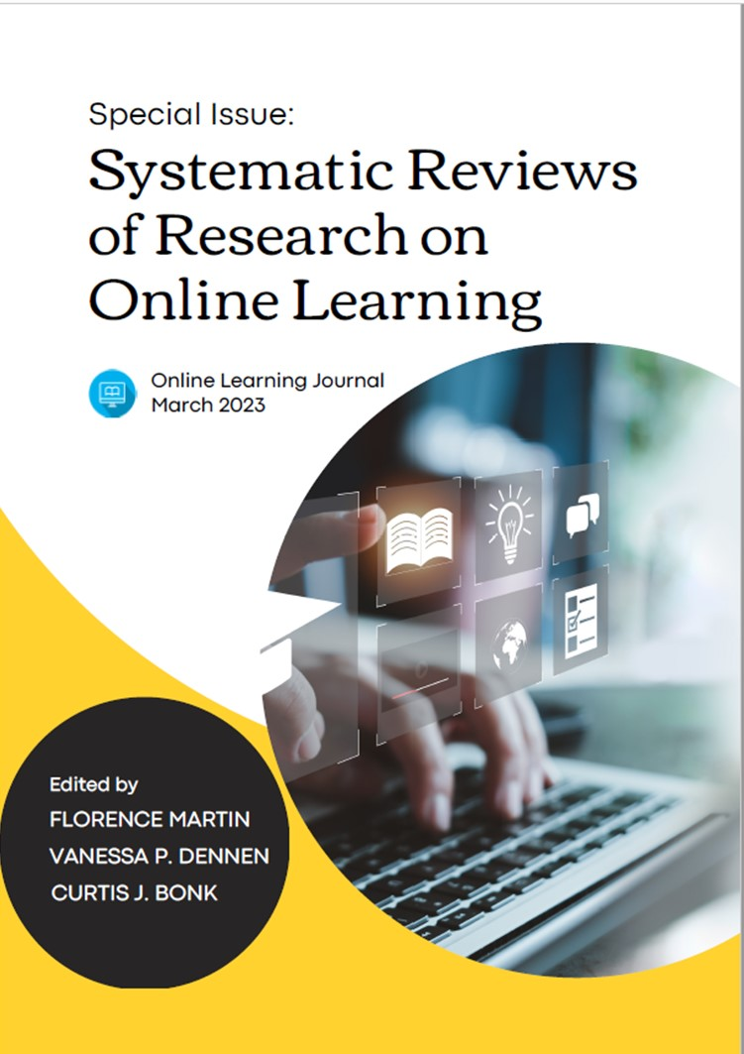
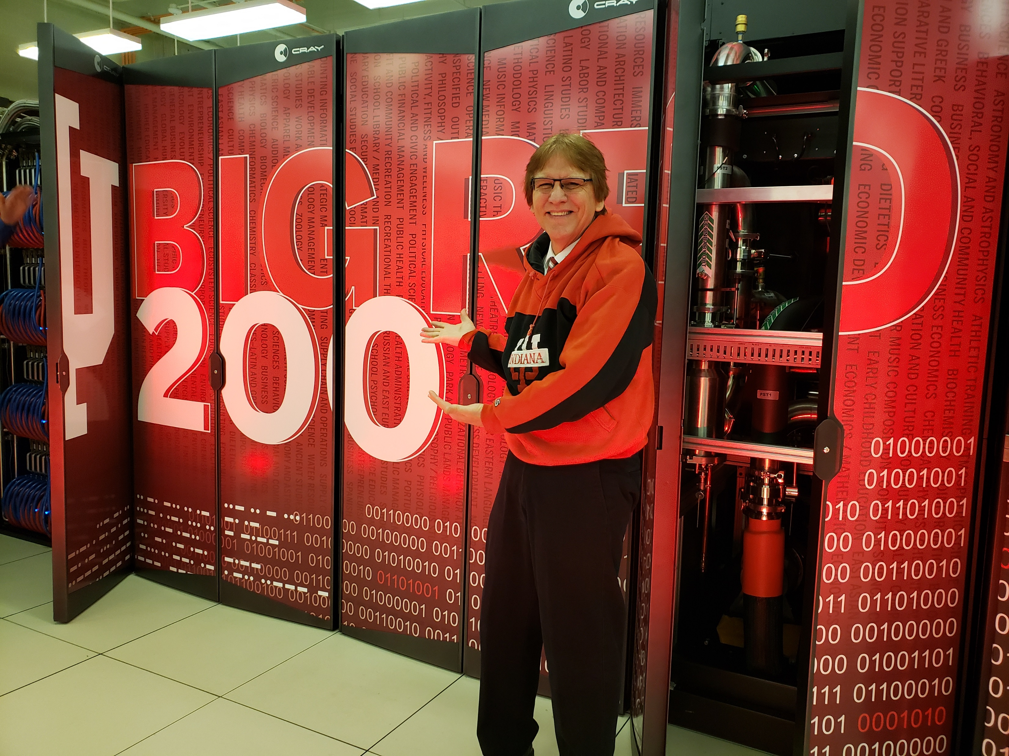
2023 free online
(Special Issue of the
Online Learning journal)

