Slide 1
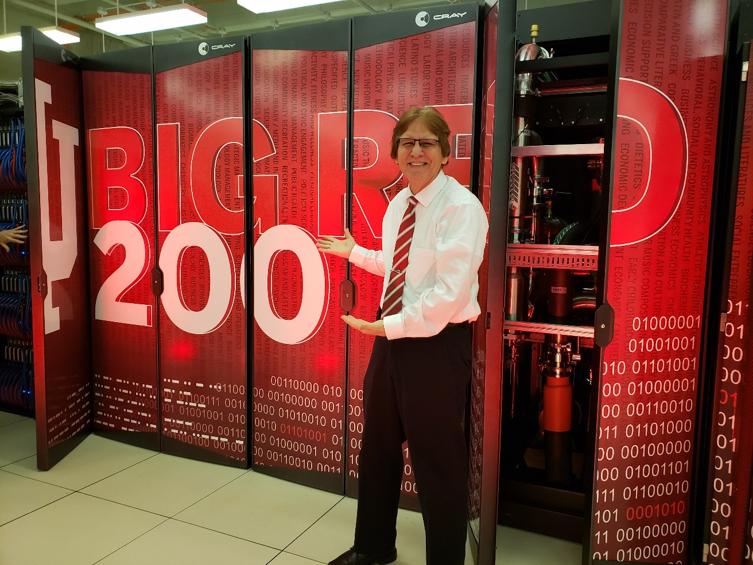
Timeline #1. CURTIS J. BONK (1977-2024)
48 years of:
Ambitions, Accomplishments,& Awards

Slide 2
Curtis J. Bonk
Ambitions, Accomplishments, & Awards
1977
Entered accounting program UW- Whitewater.
1978
McQuay-Perfex (expedite product thru plant as teen).
1979
Square
D Company (production control-- summer).
1980
Square D Company (production control--summer).
1981
BA & Passed CPA exam, hired Vrakas Blum & Co.
Hired
as Corporate Controller R&J Medical Supply.
1983
CPA License and Assistant Controller of Automated Systems, Inc (ASI).
1984
Took TV/correspond courses & applied grad school.
1985
1982
Vrakas Blum & Co as auditor and tax accountant.

Slide 3
Ambitions, Accomplishments, & Awards
1986
Entered graduate school at Wisconsin January
1986.
1987
Master’s degree Dec 1987;
Tested div/convergent software in grades 4-6.
1989
Completed entire doctoral program including dissertation in 18 months--July 1989 (with APA & UW-Madison dissertation research awards; focus grades 6-8).
1988
Entered Ph.D. program January 1988. First journal article and first book publication.
Summer of 1989 Left UW Madison and moved to West Virginia University
1990
Co-directed Project YES (Youth Enrichment Services) for inner city kids, Wheeling, WV.
Secured educational software donations from Apple for James Paige Learning Center, Wheeling WV.
Zenith Computer Masters of Innovation 1st Place (with advisee, Padma Medury).
Edit special issue of Computers in Human Behavior on Computers & Writing.
1991
1992

Slide 4
Ambitions, Accomplishments, & Awards
Summer of 1992 Moved to Indiana University
1994
First publication on cooperative hypermedia.
1995
Presented CCCW research at my first invited plenary session: The inaugural CSCL Conference, Bloomington, IN.
1996
Named first (only only) “Faculty Fellow for Technology Research” in the IU Sch of Education Center for Excellence of Educ (CEE).
Publication on combining 2 videoconferencing systems.
1993
Founded the Computer
Conferencing & Collab Writing (CCCW) Group at IU.
Co-founded the CRLT, co-authored proposal to create the “Center for Research on Learning and Technology” (CRLT), IU, School of Ed (Note: I’m the last founding member remaining at IU).
Edited “Electronic Collaborators” book with all IU authors, Erlbaum.
EC book cited as a "Breakthrough Book” for digital tech in HE.
1998
1997
Proffitt Grant, Web Conferencing for Preservice Teacher Ed.
Visiting Scholar, May 1997, Univ. of Oulu, Finland (also a visiting scholar at: Simon Fraser, Canada, 1998; U. of Newcastle, Australia, 1999; U. of Tampere, Finland, 2001; Napier U, Edinburgh, Scotland, 2006; Int’l Christian U., Tokyo, 2013; National Sun Yat-Sen U., Taiwan, 2013, Nat’l Taiwan U, 2013, George Mason U, 2022-23; American U. in Cairo, 2023; Prince of Songkla Univ., Thailand, 2023).

Slide 5
Ambitions, Accomplishments, & Awards
1999
Senior Research Fellow (1999- 2003), U.S. Army Research Institute, Consortium Research Fellows Program.
Burton Gorman Teaching Award, IU School of Ed.
2000
Wilbert Hites Mentoring Award, First Recipient, Indiana University Campuswide Award.
2001
Army Study Highlights award, Applying Collab and e-Learning Tools to Military Dist Lrng: A Research Framework by Curt Bonk & Robert Wisher.
National surveys of online & blended learning in HE and corp training, Jones Knowledge, Denver, CO.
U of Akron, Adjunct Prof, faculty mentoring prog, 2001-2003.
Senior Research Fellow (2003-3005), U.S. Dept. of Defense, ADL Lab, Dept. of Defense, Research on MMOG.
Most Outstanding Achievement by an Individual in Higher Ed Award, U.S. Distance Learning Assoc.
Innovative Teaching Award: Teaching in Distance Ed Prog, Indiana Partnership for Statewide Ed, IHETS.
2003
Led Kelley Direct online MBA research team at IU (2004 - 2007).
The Perfect E-Storm, Commissioned paper, Observatory on Borderless Higher Ed, London, UK.
Alumni Achievement Award, Univ. of Wisconsin School of Education.
2002
CyberStar Award, Indiana Info Tech Assoc (INITA), Indy, IN. Award for: “Educ Contrib to IT in Higher Education.”
2004

Slide 6
Ambitions, Accomplishments, & Awards
2005
Commisioned by U.S. DOD: Massive
multiplayer online gaming: A research framework for military educ and training. Adv Distrib Lrng (ADL) Initiative.
Int’l surveys conducted on blended learning in corp training in Korea, China, Taiwan, the UK, & USA.
2006
Outstanding Paper Award, Does sense of community matter? E- Learn 2006, Honolulu, Hawaii.
Published: The Handbook of
Blended Learning: Global Perspectives, Local Designs.
2007
Class Wikibooks produced:
The Web 2.0 & Emerging Lrng Tech (The WELT).
The Practice of Learning Theories (The POLT).
Named Visiting Professor, U. of South Wales, 2007-2017.
Executive Committee Chair, Advisory Board, E-Learn Conference, AACE.
Bonk, Lee, & Reynolds (Eds.). Special Issue and book: A Special Passage through Asia E-Learning.
Outstanding Paper Award, Wikibooks and Wikibookians: Loosely-Coupled Community or the Future of the Textbook Industry?, Ed Media.
2009
2008
Published: Bonk & Zhang (2008). Empowering Online Learning: 100+ Activities for Reading, Reflecting, Displaying, & Doing. Jossey-Bass.
Major Preconference Symposium Co-Coordinated:
International E-Learn Conference, Topic: E- Learning in Asia (2008, Las Vegas).

Slide 7
2010
Ambitions, Accomplishments, & Awards
2012
IAP DDL Dist Ed Journal Article Award, 2012-First Place for “Advancing Practice,” Division of DL of AECT.
2013
Major Preconference Symposium Co-Coordinated: Int’l E-Learn Conference, MOOCs & Open Ed (Las Vegas).
2011
The World is Open book
is translated to Arabic and Chinese (Bestseller in China with 20,000 copies sold).
Conference
Co-Founder & Executive Committee, Global Learn Asia-Pacific: Global Conf on Learning & Tech,
AACE (First held in Penang, Malaysia).
Chinese Translation by BNU of "Adding Some TEC-VARIETY" book (free to download).
In June 2015, I gave 18 talks at 12 universities in 6 cities in China (Hong Kong, Shenzhen, Guangzhou, Hangzhou, Shanghai, and Beijing).
Published MOOCs & Open Ed Around the World published by Routledge (translated to Korean & Chinese).
Named “Guest Professor,” South China Normal U, Guangzhou, 2015-2018.
AECT Division of Distance Learning (DDL) Distance Education Book Award. 2016 -- First Place. MOOCs and Open Education Around the World.
AACE Fellowship Award "In Rec of Outstanding Leadership & Service to the Profession & AACE."
Outstanding Contribution to eLearning, Global TechLearn Congress and Awards, Mumbai, India.
2016
2014
Mildred B. and Charles A. Wedemeyer Award for Outstanding Practitioner in Distance Educ Award, UW-Madison, Wisconsin DT&L Conf.
Outstanding Contrib. to Educ. Global TechLearn Congress and Awards, Mumbai, India.
2015

Slide 8
Ambitions, Accomplishments, & Awards
2018
RHSU Edu-Scholar Public Presence Rankings
(top 200 list from over 20,000 university-based education scholars in the USA) for contributing to the debate about schools and schooling, Education Week. Made list from 2012-2018.
2019
Co-edited book: MOOCs and Open Education
in the Global South: Challenges, Successes, and Opportunities.
2020
IU President’s Award for Excellence in Teaching and Learning Technology.
Co-edited ETR&D special Issue on Systematic Reviews of Research on Learning Environments and Technology.
Research Associate at Contact North/Contact Nord, Ontario, Canada.
Featured in a series of frontpage stories on Future of K-12 Educ., Herald Times.
Reached goal of 20 publications in 2020.
2017
Online Lrng Journal
Outstanding Research Achieve Award in Online Ed, Online Learning Consortium.
Preconference Symposia Coordinated: E-Learn Conf, MOOCs and Open Education in Developing World.

Slide 9
Ambitions, Accomplishments, & Awards
2021
David H. Jonassen Excellence in Research Award, AECT, Chicago, IL.
AECT Division of Distance Learning (DDL) First Place Journal Article Award with former IST student, Dr. Min Young Doo. “A meta-analysis of scaffolding effects in online learning in higher education. IRRODL.”
2022
Co-edited book of stories of Fulbright teachers (2022): Transformative Teaching Around the World:,” Routledge.
2. Book, Engaging Online Language Learners. DC: TESOL.
3. Book, Motivating and Supporting Online Learners, COL.Org.
4. Fellow, AERA
5. Outstanding Digital Learning Artifact Award, AECT.
6. AECT/ETR&D Distinguished Development Award
2023
Special issue of the Online Learning journal.
Fellow, Online Learning Consortium.
AECT Annual Achievement Award.
Outstanding Book Award AECT
USDLA Excellence in Distance Learning Research Award in HE.
Awardee, Outstanding Int’l Research Collaboration with Min Young Doo
Stanford University list of top 2% of scientists in the world for career.
2024
???
See the following pages for visual examples…

Slide 10
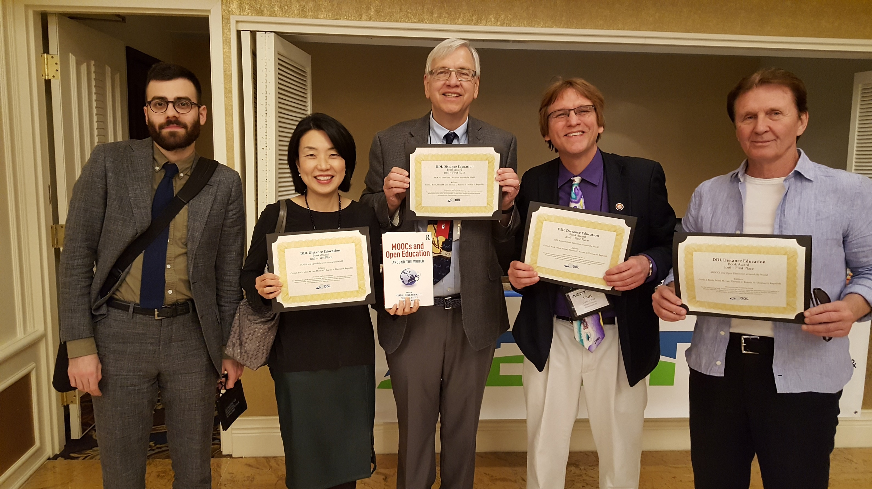
Book Project Collaborations By Year
Note: Two of my edited books feature entirely IU School of Education contributors
(e.g., Electronic Collaborators (1998) and Transformative Teaching Around the World (2022).

Slide 11
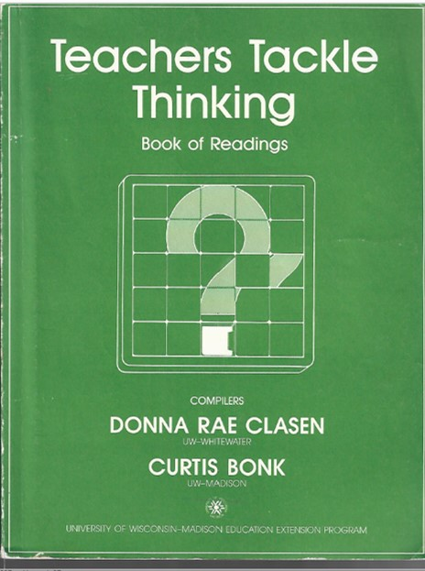
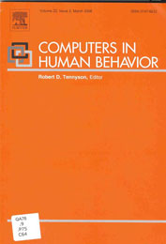
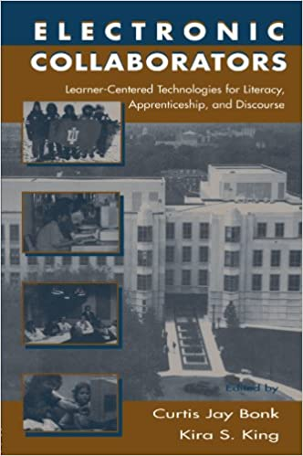
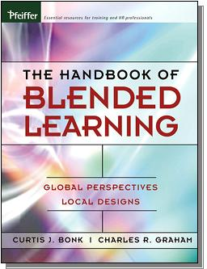
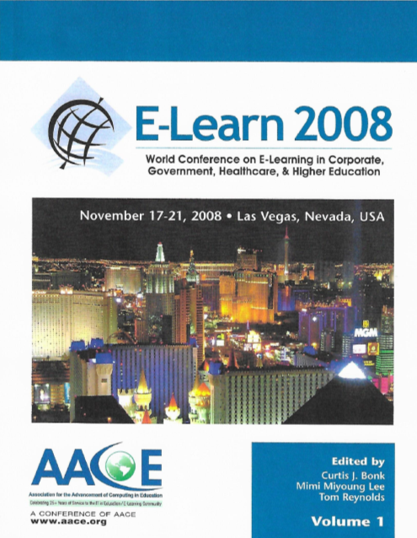
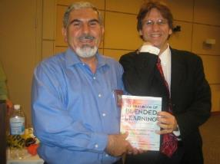
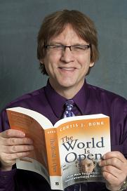
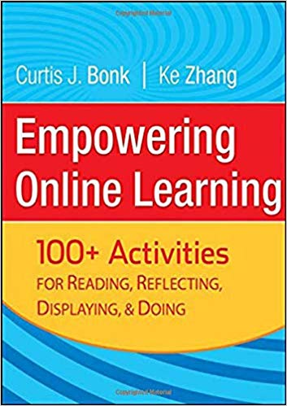
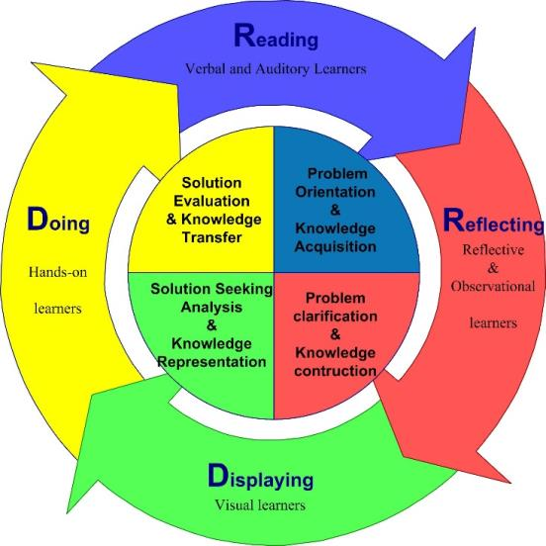
Special Issue:
Computers and
Writing
W. Michael Reed
Curtis Jay Bonk
1988
1992
1998
2000
2006
2008
(All contributors affiliated
with the IU School of Ed)
2008
2009
2009 (Expanded for paperback edition in 2011)
Notes:
World is open book

Slide 12
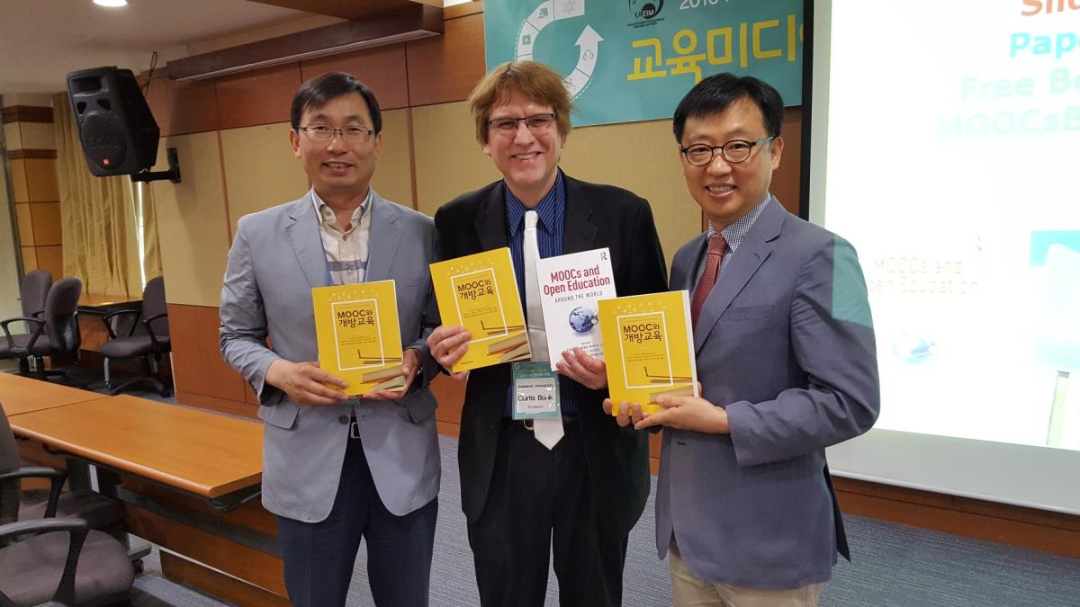
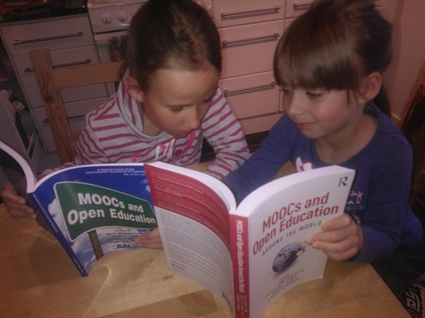
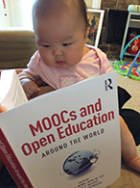
2014 (Free English & Chinese in 2015)
2015 (Chinese and Korean in 2016)
2015
2020
August 2020

Slide 13
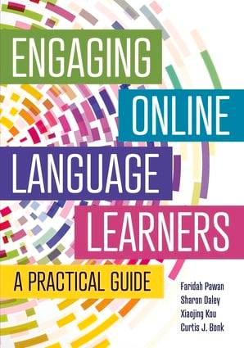
2022
(Free book and course
Khoo & Bonk
Commonwealth of Learning)
2022
(published by TESOL)
2022
(All contributors affiliated
with the IU School of Education)

Slide 14
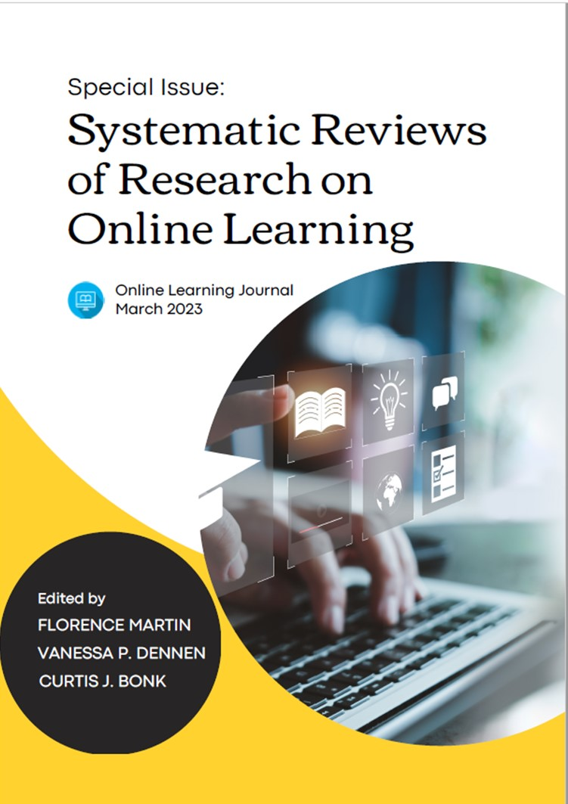
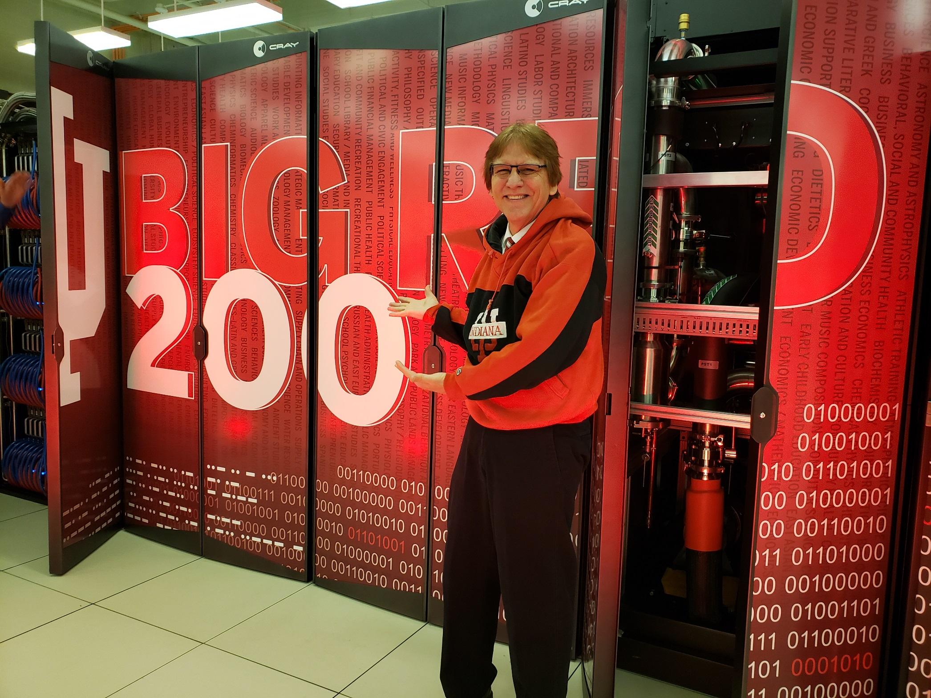
2023 free online
(Special Issue of the
Online Learning journal)

