Slide 1
Timeline #2. CURTIS J. BONK (1977-2024)
48 years of:
Technological Innovations & Experimentations
Notes:
Editable

Slide 2
Curtis J. Bonk: Tech Innovations
Entered Field of Business (First 9 years—IT Corporate)
1977
1978
1979
1980
Designed first computer program in BASIC as a high school senior.
Helped streamline production and inventory control record keeping for McQuay-Perfex as a teenager.
Helped
automate production and inventory control record keeping for Square D Company.
Helped
automate production and inventory control record keeping for Square D Company.
Automated ASI financial systems--timeshare system, $15 million revenues.
Migrated ASI financials to a personal computer–budgets, cash flow, etc.
1983
Automated R &J Medical Supply financial systems, $10 million revenues.
1984
1985

Slide 3
Curtis J. Bonk: Tech Innovations (The next 35 years—Ed Tech)
Left Business Career in January 1986 for Grad School at UW Madison in the Field of Educational Psychology
1986
1987
1988
1989
Created two video documentaries (mental health institute & two research parks), Madison, WI.
Designed
4 summer computer camps in rural Wisc. communities.
Co-created nationally
distrib telecourse "Teacher Tackle Thinking: Critical Thinking in the Classroom," UW Extension.
Co-developed
keystroke mapping and computer prompting system.
Summer of 1989 Left UW Madison and moved to West Virginia University
Testing the “Knowledge Builder” and other collab writing tools.
Continued design and support of the James Paige Learning Center.
Classroom of the Future at WVU—3 yrs (Chair of Committee).
Coined term “cooperative hypermedia” (see 1994 publication).
Create five-level Hierarchy of Collab Writing Technologies.
1990
Co-founded and designed James Paige Learning Center & Computer Lab for at risk youth, Wheeling, WV.
1991
1992

Slide 4
Curtis J. Bonk: Tech Innovations
Summer of 1992 Moved to Indiana University
1993
1994
1995
1996
Taught
perhaps first blended learning course in the IU Sch of Educ.
Project Blue Skies
(Indiana Weather Project): kids in rural, urban, suburban Indiana investigate
meteorology via the Web.
Combined
2 videoconferencing systems: CU-SeeMe and PictureTel.
Conferencing on the Web (COW) case learning with IU preservice teachers (1996-2001).
1. Developed “Bobweb” R546 website (Grant Continuing Studies Dept).
2. Web & Videoconferencing in Preservice Teacher Training grant.
3. TICKIT project for rural Indiana teachers. Funded 5 years (1998-2003).
4. Developed INSITE Web site to support ed psych textbook (a first).
5. TITLE Project: "The Intraplanetary Teacher Learning Exchange."
6. Developed Caseweb; set of cases for educ psych, Funded by IU.
1997
Taught second fully online courses in SOE at IU, “the Smartweb” for ed psych students.
Developed suite of Web tools for LMS.
1998

Slide 5
1999
2000
2001
Devel of first online ed psych reader/coursepack, Bell & Howell.
Founded CourseShare, LLC for course and resource sharing.
TICKIT AND TITLE inservice and preservice teacher projects continue.
Funded/dev, free sharing portals, InstructorShare, ResourceShare.
Technology contributor for major undergraduate textbook Psychology Applied to Teaching, Boston, MA; Houghton Mifflin.
TICKIT AND TITLE inservice and preservice teacher projects continue.
Developed a Ten Level Web Integration Continuum for HE.
Funded/Developed free sharing portals, BookstoreShare, UniversityShare.
TICKIT AND TITLE inservice and preservice projects continue.
Founded, funded, and developed SurveyShare (over 100,000 surveys created; millions of survey respondents); sold in 2010.
TICKIT project for rural Indiana teachers continues.
Features added to SurveyShare.com & usability testing.
Designed TEC-VARIETY framework for motivating online learners.
2002
Funded/devel free sharing portals, LibraryShare, TrainingShare.
TICKIT project for rural Indiana teachers continues.
2003
2004

Slide 6
Curtis J. Bonk: Tech Innovations
2005
2006
2007
Funded development of
initial prototype for QuizShare.com.
Overhaul and features upgrades added to SurveyShare.com.
Initial pilot of wikibooks (IU & University of Houston).
Coordinated cross-institutional & cross-cultural wikibook projects (China,Malaysia, Taiwan, IU, U of Houston, & Indiana State U).
Expanded Web Integration Continuum Model to 12 Levels.
Featured several times in video series on online and blended learning, for Distance Ed Report, Magna Publications, Madison, WI.
Featured several times in Starlink video series on blended/online learning and the Web 2.0, Dallas, TX (October 2008-January 2010).
Published: The World is Open: How Web Technology is Revolutionizing Education, Jossey-Bass/Wiley.
2008
Developed R2D2 Model (Read, Reflect, Display, and Do).
Produced 8-pack of learning theory video lectures (open access; used globally).
2009

Slide 7
Curtis J. Bonk: Tech Innovations
2010
2011
2012
2013
Produced 27 free online
teaching training videos for IU (over 165,000 downloads): Video Primers in an Online
Repository for e-Tchg & Lrng (V-PORTAL).
Coined the term
“extreme learning” and led a research team of over 20 people to conduct
research on it.
Taught first MOOC at
IU and Blackboard, using CourseSites. Title: “Instructional Ideas and Tech Tools for Online Success.” (nearly 4,000 enrolled)
Pilot tested new tool
at the E-Learn Preconference called Flipgrid (now owned by Microsoft and used
by hundreds of millions).
Developed MOOCsbook.com website for 3 MOOCs and Open Education books published in 2015 & 2020. See: http://moocsbook.com/.
Featured in blended
learning program, PBS Cincinnati, “Putting the Blend in Blended Learning,” Public Media Connect--CET/ThinkTV.
2014
Published free Digital Textbook: Adding Some TEC-VARIETY: 100+ Activities for Motivating and Retaining Learners Online: http://tec-variety.com/; 250,000+ downloads.
2015
2016

Slide 8
Curtis J. Bonk: Tech Innovations
2017
2018
2019
2020
Master’s student
training videos, MOOCs and Self-directed Learning, Universitat
Oberta de Catalunya (i.e., the Open University of Catalona), Barcelona,
Spain (video playlist).
Combined two
videoconferencing systems in Room 2101 of the School of Education to being in
guest speakers from around the world—Cisco Crestron system and Zoom.
Using live video chats with experts and recorded shared online videos of experts to enhance learner engagement.
Combined two videoconferencing systems to being in guest speakers from around the world—Cisco Crestron system and Zoom.
Co-host of “Silver
Lining for Learning” weekly Webcast series discussing the future of education (with Chris Dede, Harvard, Punya Mishra, ASU, and Yong Zhao, Univ. of Kansas).

Slide 9
Curtis J. Bonk: Technology Innovations
2021
2022
2023
2024
“Silver Lining for Learning” weekly Webcast Show Season #2.
Pilot testing technology in Woodburn Hall Room 203--the ALCOVE (Active Learning Classroom of Valuable Experiences) from UITS at Indiana University.
“Silver Lining for Learning” weekly Webcast Show Season #3.
Continued Pilot testing technology in Woodburn Hall Room 203--the ALCOVE (Active Learning Classroom of Valuable Experiences) from UITS at Indiana University.
“Silver Lining for Learning” weekly Webcast Show Season #4.
Incorporated Generative AI into a Series of Assignments.
“Silver Lining for Learning” weekly Webcast Show Season #5.
Pilot test Microsoft Copilot.
Expanded Generative AI Pedagogical Experimentation.
See the following pages for a few visual examples…

Slide 10
A Few Sample Technology Projects (1986-2024)

Slide 11
1988-1989 Dissertation Project Co-developed and tested a keystroke mapping system and computer prompting system in WordPerfect (with Tom Reynolds, UW Madison) (10 minute Video demo).

Slide 12
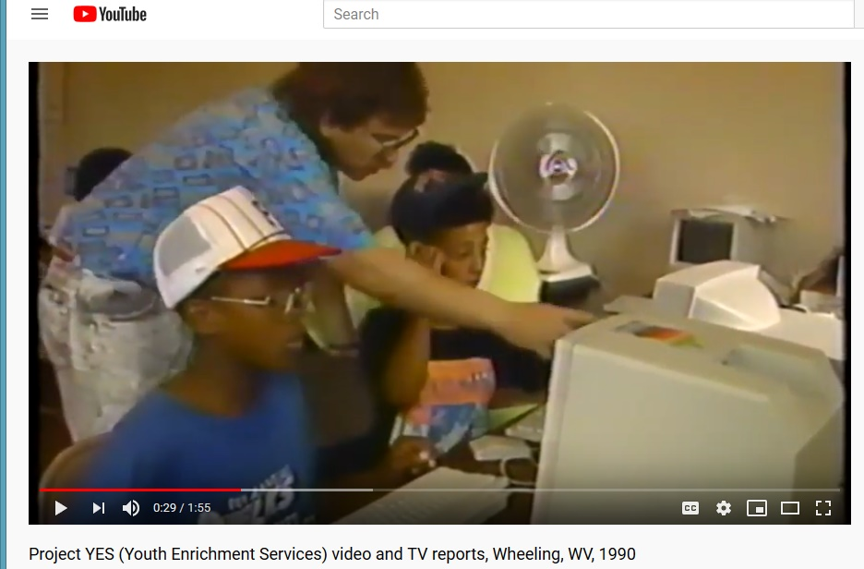
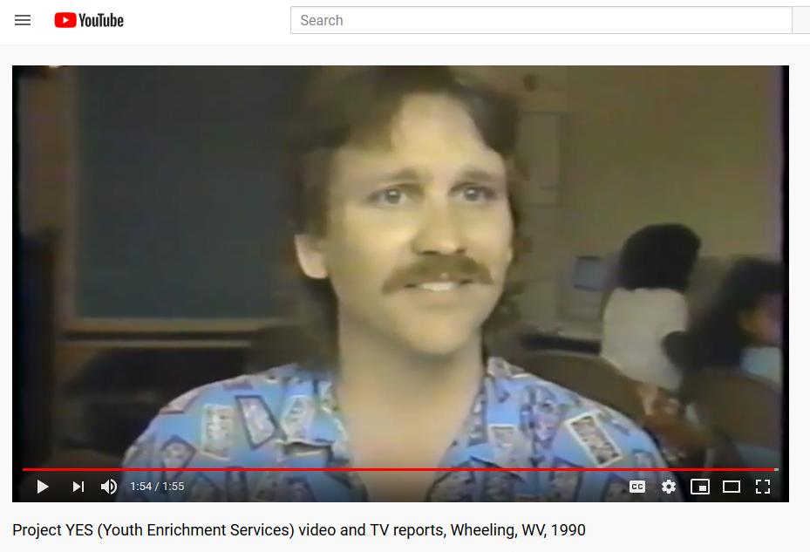
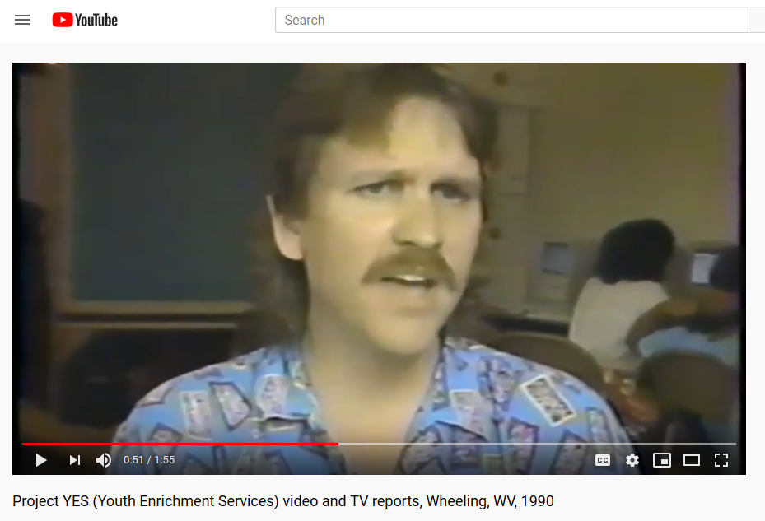
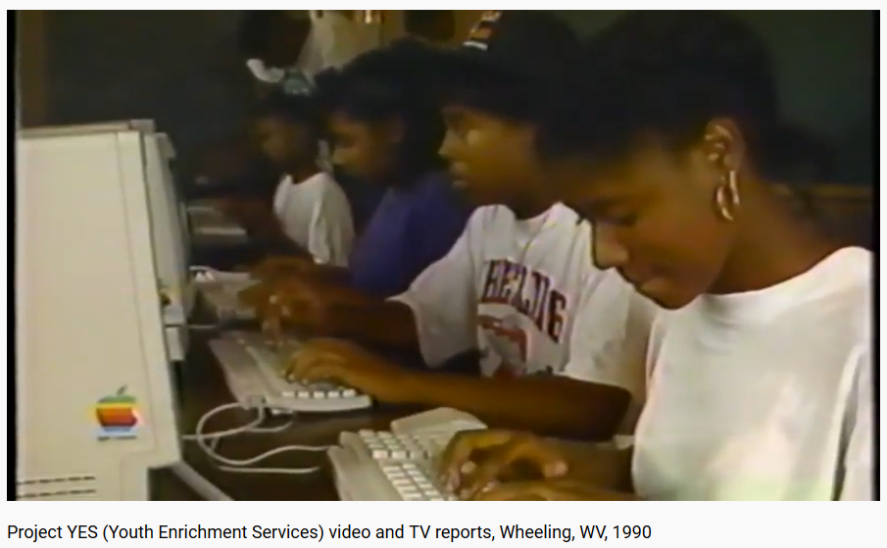
1990-1992 Project YES: Youth Enrichment Services Co-Founded the James Paige Learning Center and associated computer lab for at-risk youth in Wheeling, WV (2 minute news Video and interview)

Slide 13
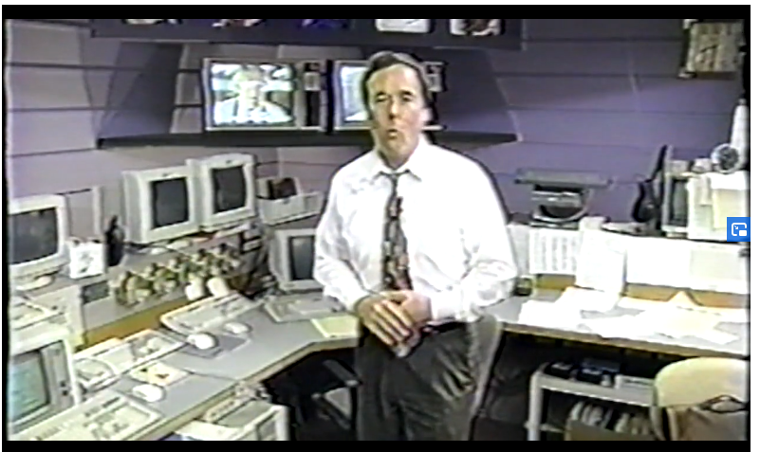
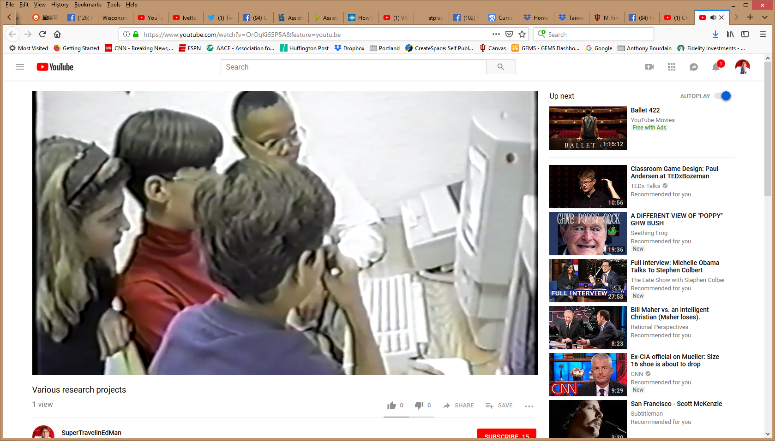
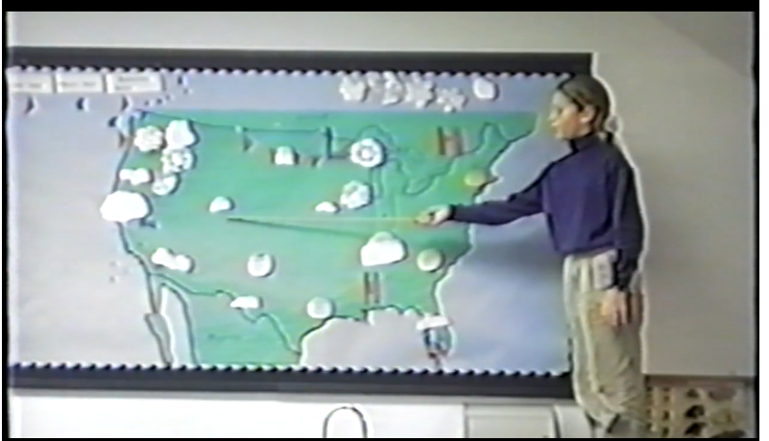
1994-1995 (Co-designed with Dr. Ken Hay, IUPUI) Project Blue Skies/Indiana Weather Project (IWA) for meteorology with kids in rural, urban, and suburban Indiana schools investigate meteorology via the Web (and Chris Wright from WISH-TV) with IU InterCampus Research Grant. (15 minute Video demo)

Slide 14
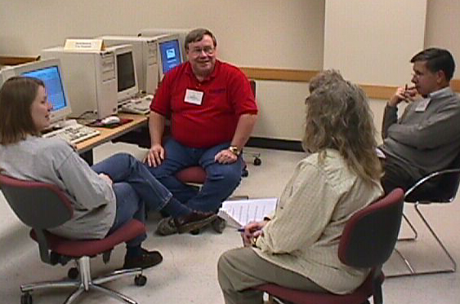
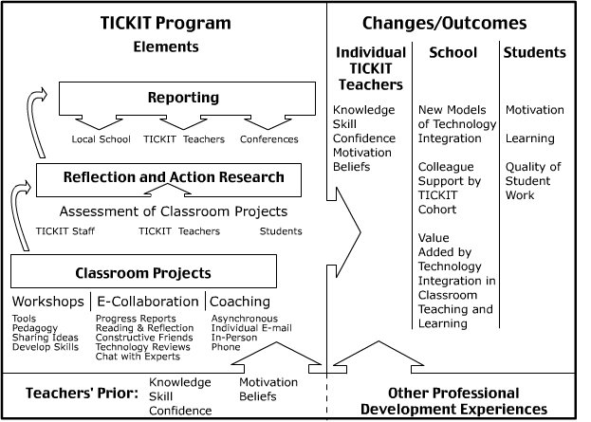
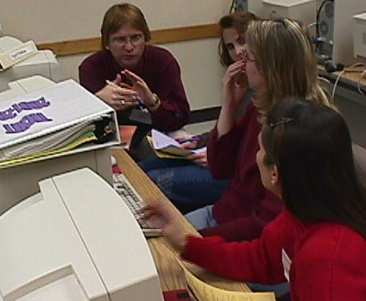
1998-2003 (co-designed with Dr. Lee Ehman, C&I Dept.) TICKIT (Teacher Institute for Curriculum Knowledge about the Integration of Technology in south and central rural Indiana schools)

Slide 15
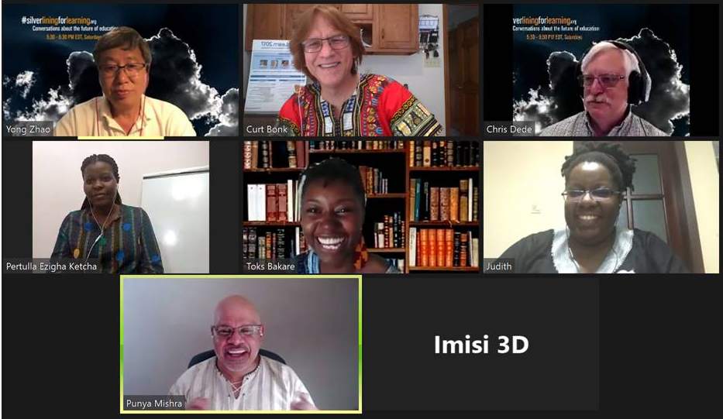
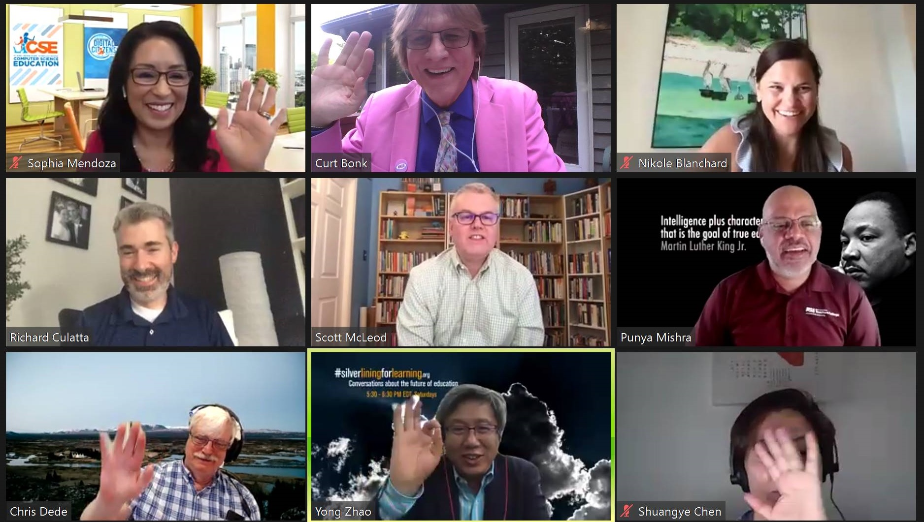
2020-2024 (Co-Host, Silver Lining for Learning Webcast Initiative) (Weekly Webcast show: New Educational Models and Ideas: 181 Episodes to Date) https://silverliningforlearning.org/ https://silverliningforlearning.org/episodes/

Slide 16
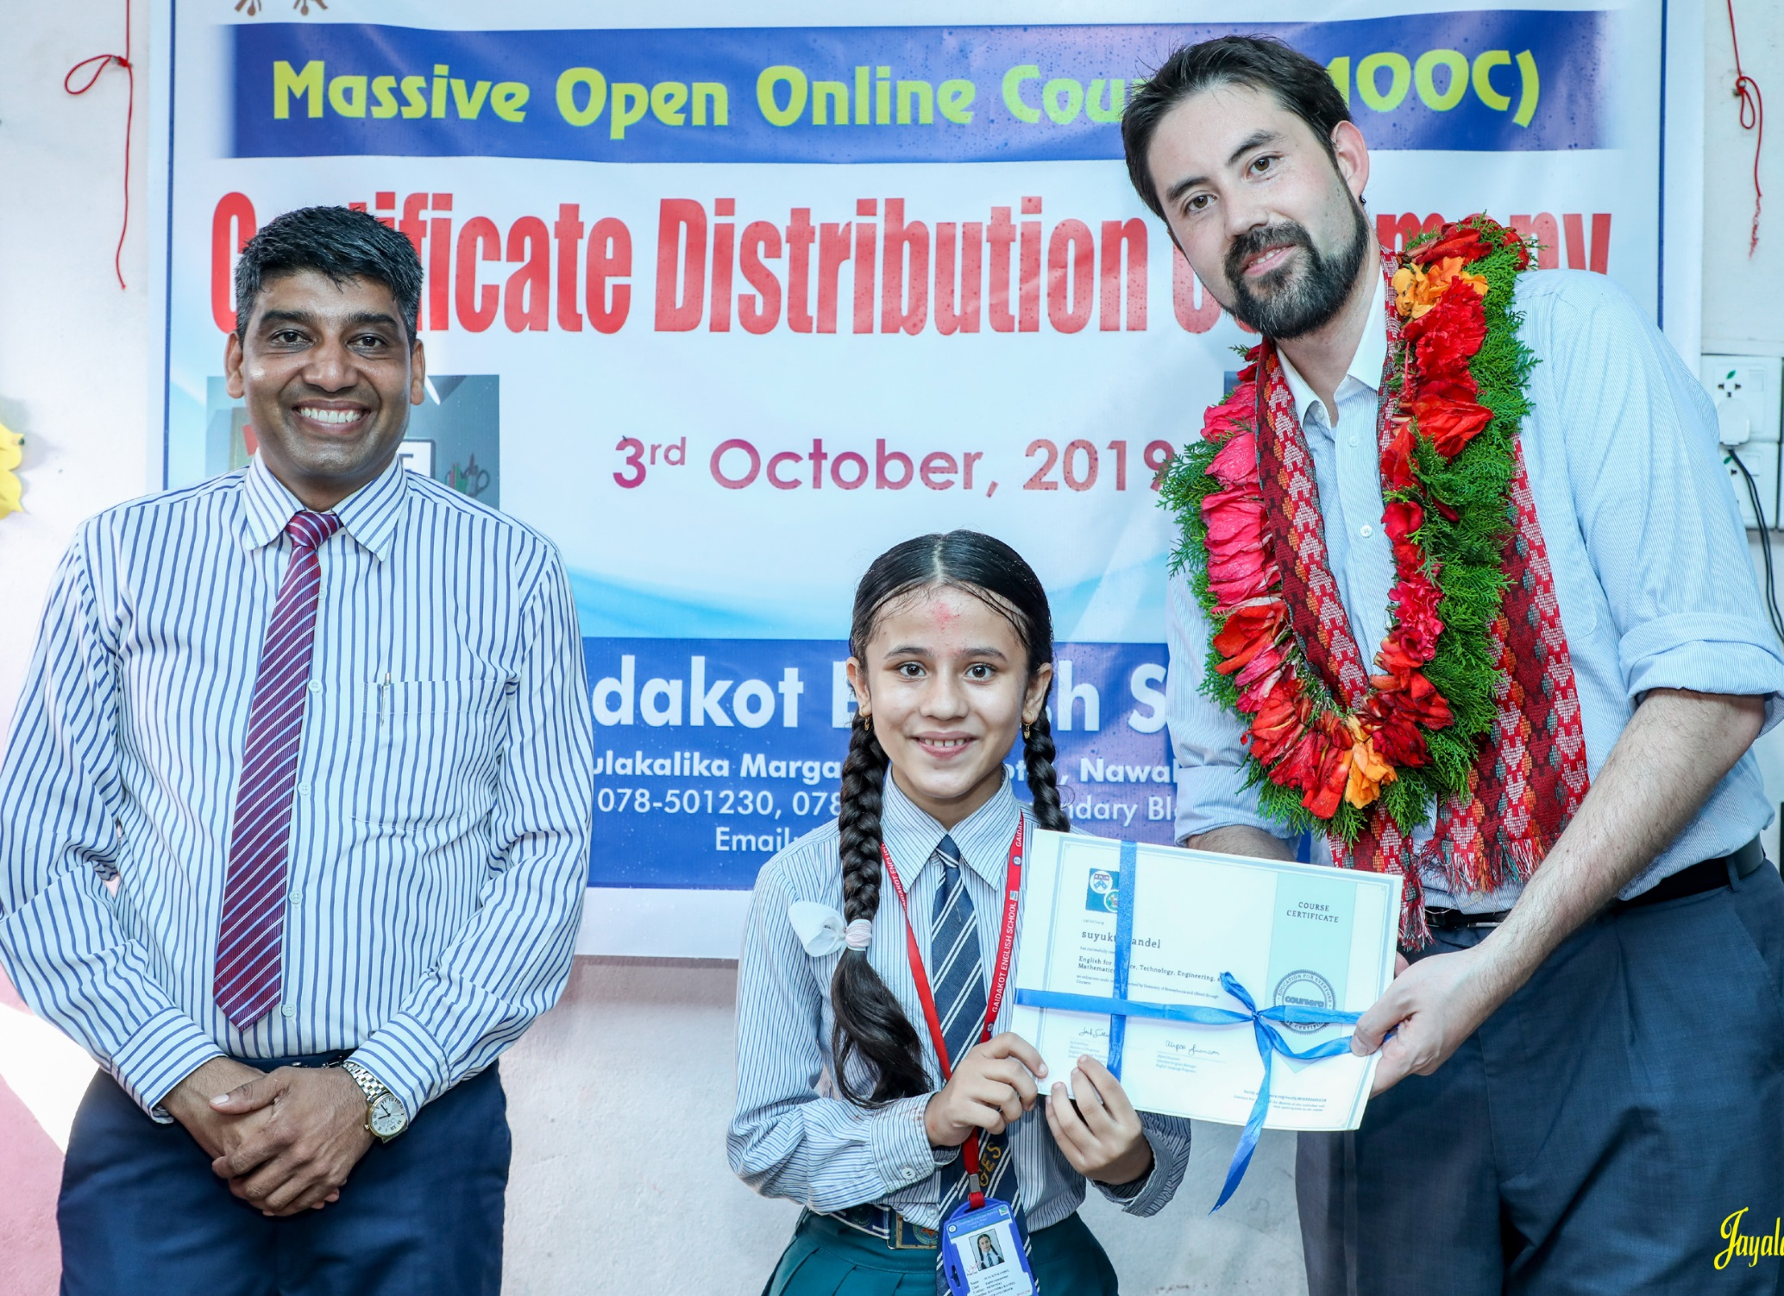
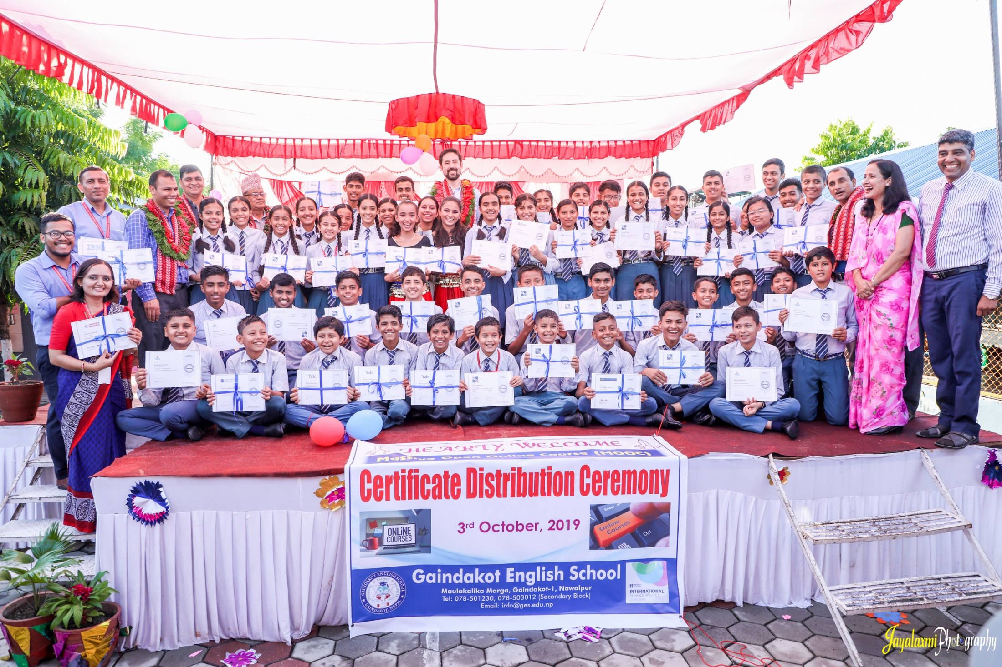
2020-2022 Researching Adolescent Youth Self-Directed Learning (SDL) from MOOCs in Nepal

Slide 17
Sample Global Webinars on Learning Technology and Teaching Online

Slide 18
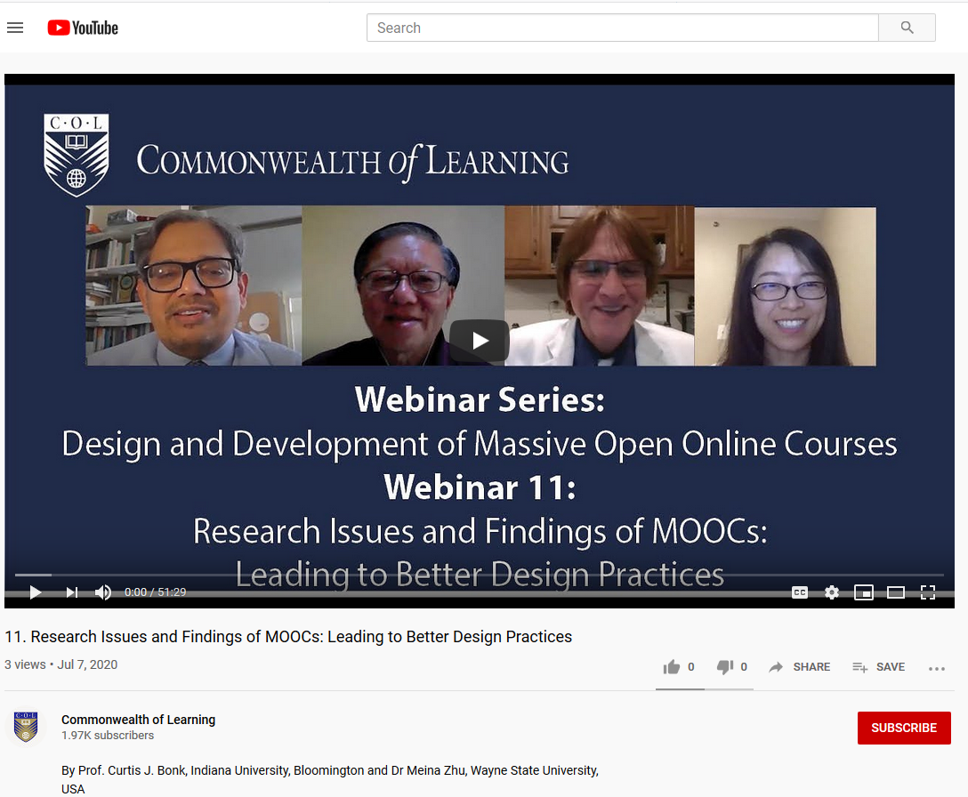
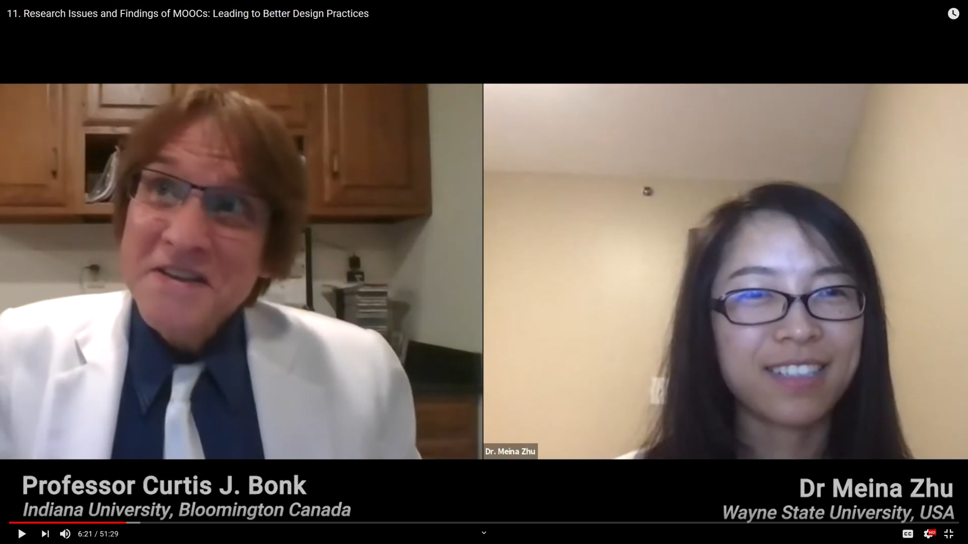
May 27, 2020 (sample Webinar) Webinar by Curt Bonk and Meina Zhu on "Research Issues and Findings of MOOCs: Leading to Better Design Practices" for the Commonwealth of Learning (COL), Vancouver, BC, Canada (99 participants from seven countries, e.g., Bangladesh, Canada, India, Japan, Malaysia, Trinidad, and Tobago, and USA). https://youtu.be/kmsWZi3vyrg

Slide 19
June 29, 2020 (sample Global Webinar) Webinar in Zoom to 346 people from 60+ counties (650 signed up) Topic: “How to Motivate and Retain Learners Online.” Featured free webinar for Contact North, Ontario, Canada. Available: https://youtu.be/1uMc7pOO2to

Slide 20
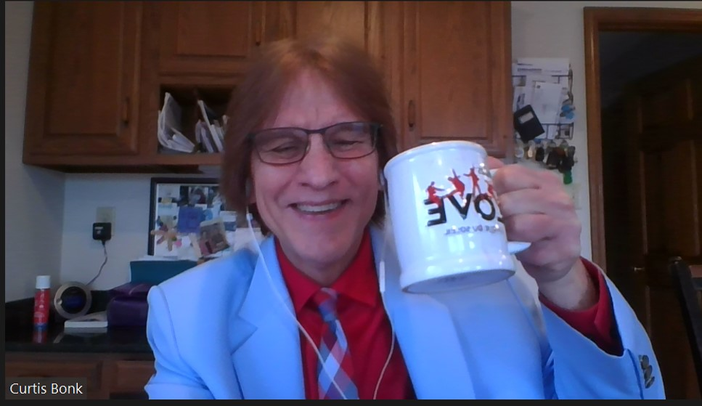
February 8, 2024 (sample Global Webinar) Webinar in Zoom to 144 people from 35 counties (307 signed up) Topic: “How Faculty can Harness Generative AI for Enhanced Learning.” Featured free webinar for Contact North, Ontario, Canada. Available (Video: 1:11:50): https://youtu.be/vaJm_6l9nqU Slides: https://www.trainingshare.com/workshop.php#cncd2023 Abstract: https://teachonline.ca/webinar/how-faculty-can-harness-generative-ai-enhanced-learning

